Slide 1
Socially-Aware Self-Supervised
Tri-Training for Recommendation
Advisor : Jia-Ling, Koh
Speaker : Hsiao-Ting Huang
Source : KDD 2021
Date : 2021/12/28

Slide 2
Outline
Introduction
Method
Experiment
Conclusion

Slide 3
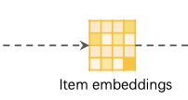
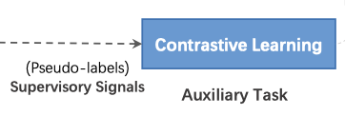
Introduction
Most existing SSL-based methods conduct the self-discrimination based contrastive learning over different views to learn generalizable representations.

Slide 4
Contrastive Learning
positive pair
K⁻
K⁺
q
negative pair
z⁺
z
z⁻

Slide 5
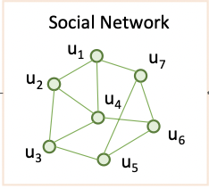
Introduction
For supplementary views that can capture the homophily among users, we resort to social relations
Notes:
With these research effort, the field of self-supervised recommen- dation recently has demonstrated some promising results showing that mining supervisory signals from stochastic augmentations is desirable [29, 46]. However, in contrast to other graph-based tasks, recommendation is distinct because there is widely observed homophily across users and items
通過這些研究工作，自監督推薦領域最近展示了一些有希望的結果，表明來自隨機增強的挖掘監督信號是可取的。
然而，與其他基於圖的任務相比，推薦是不同的，因為在用戶和項目之間廣泛觀察到同質性。
大多數現有的基於 SSL 的方法在增強視圖上進行基於自我辨別的對比學習，以針對原始數據中的方差學習可概括的表示。

Slide 6
Tri-training
Self-training
Co-training：
requires two sufficient, redundant and conditionally independent views
Tri-training :
initializes three diverse classifiers upon three different data views generated via bootstrap sampling

Slide 7
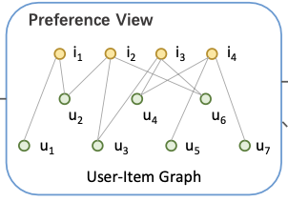
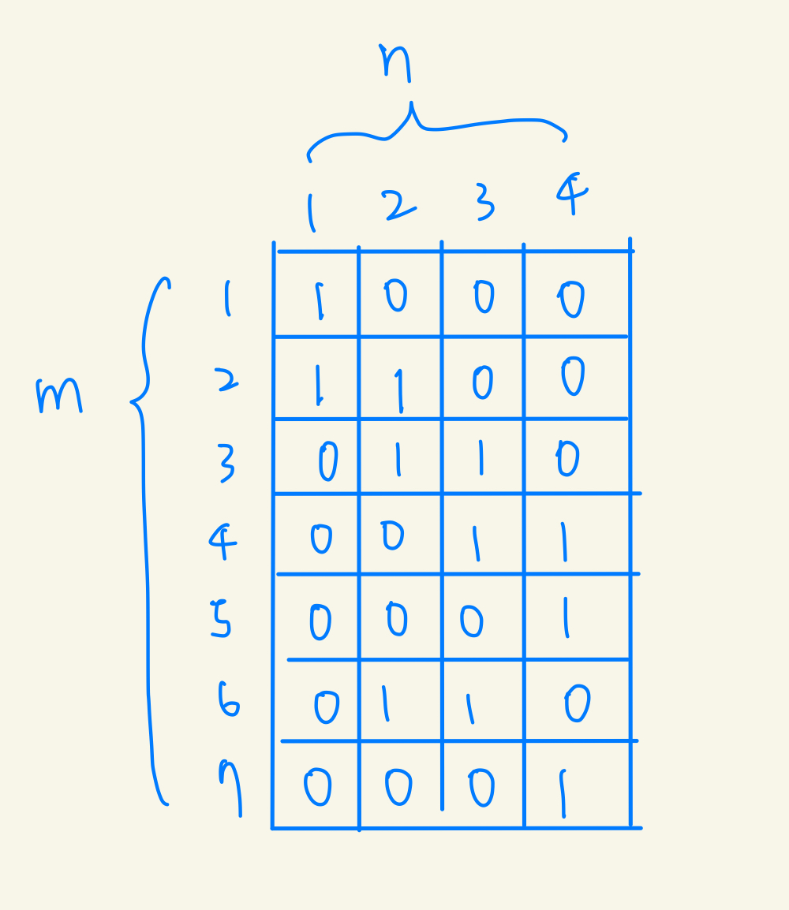
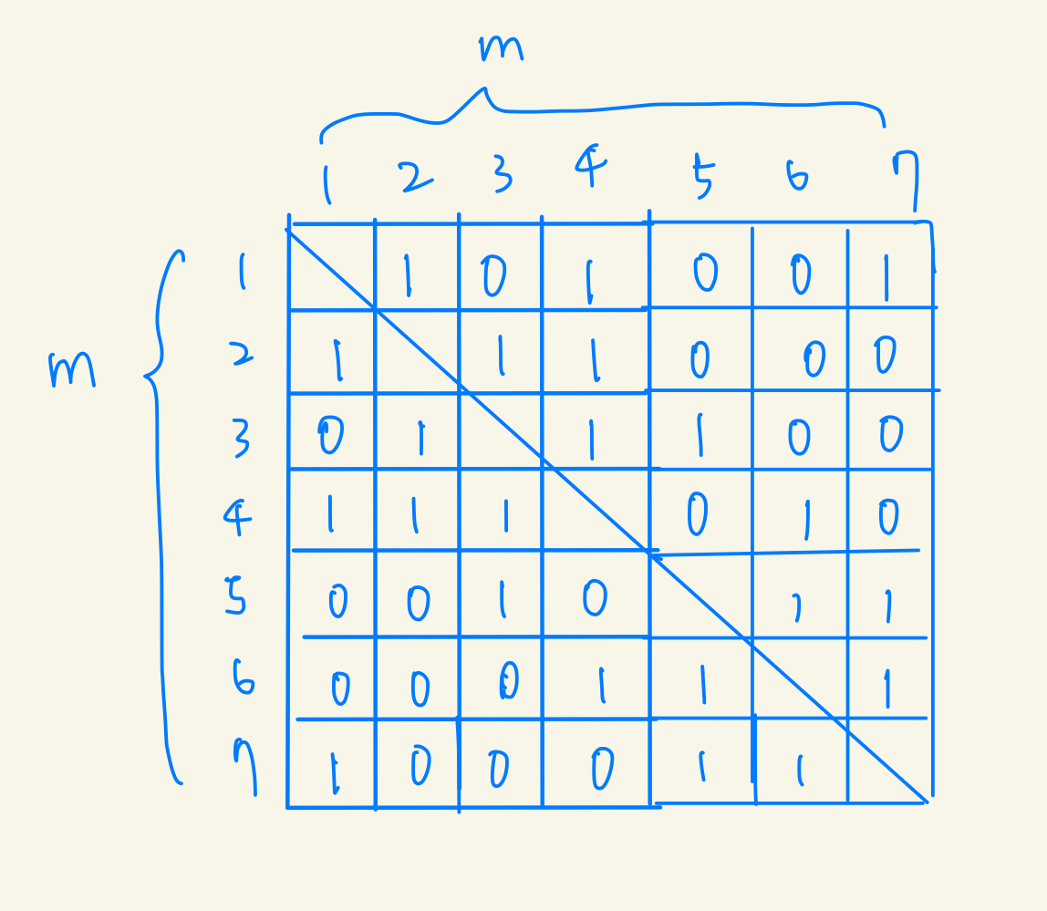
Input & Output
𝑹 ∈ R^{𝑚×𝑛}
𝑺 ∈ R^{𝑚×𝑚}
Notes:
𝑹 ∈ R^{𝑚×𝑛} is the binary matrix with entries only 0 and 1 that rep- resent user-item interactions in G^{𝑟}
As for the social relations, we use 𝑺 ∈ R^{𝑚×𝑚} to denote the social adjacency matrix which is binary and symmetric because we work on undirected social networks with bidirectional relations.

Slide 8
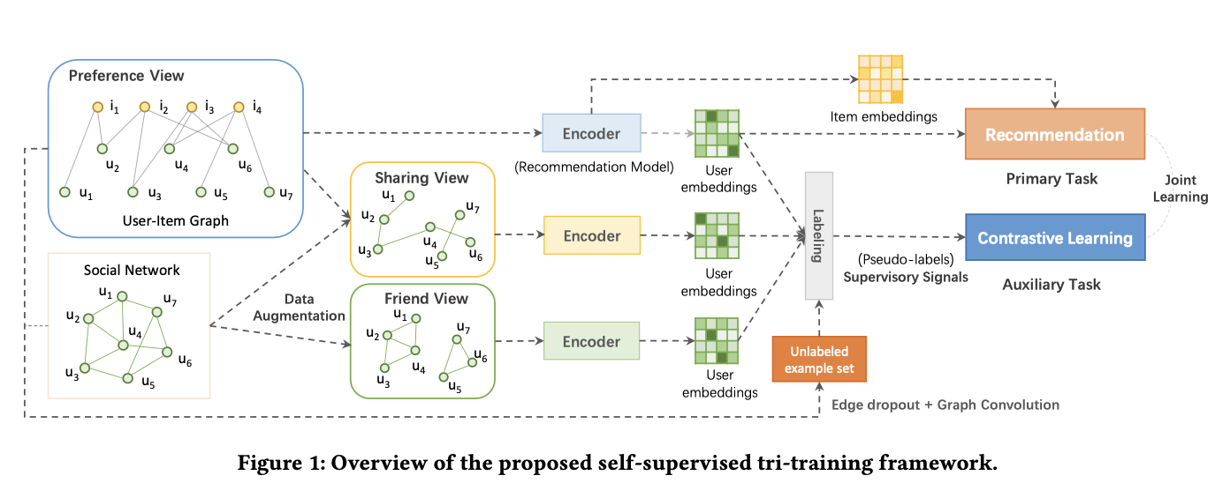
Framework
Self-Supervised
Tri-Training
G_{r}
H_{r}
A_{s}
H_{s}
H_{f}
G_{s}
A_{f}
Data Augmentation

Slide 9
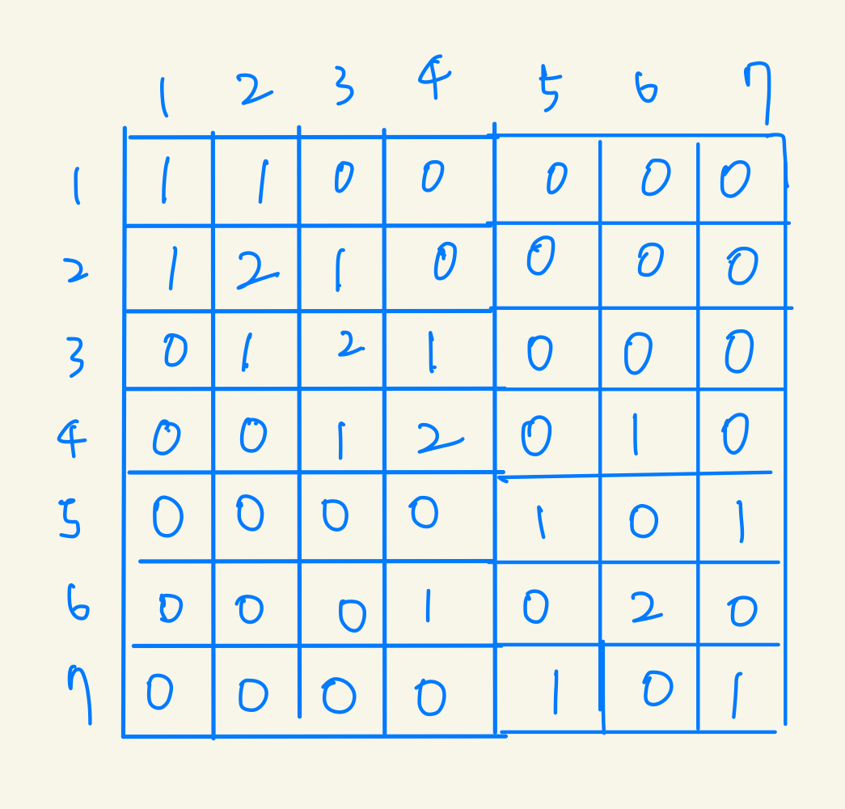
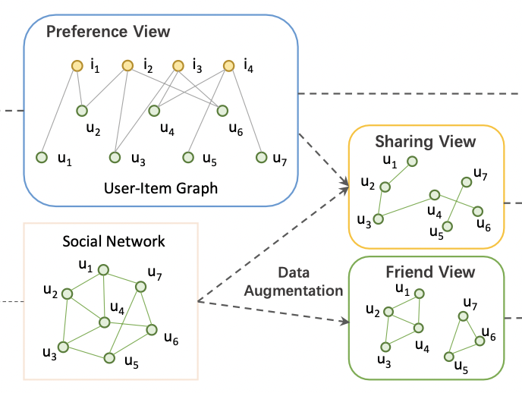
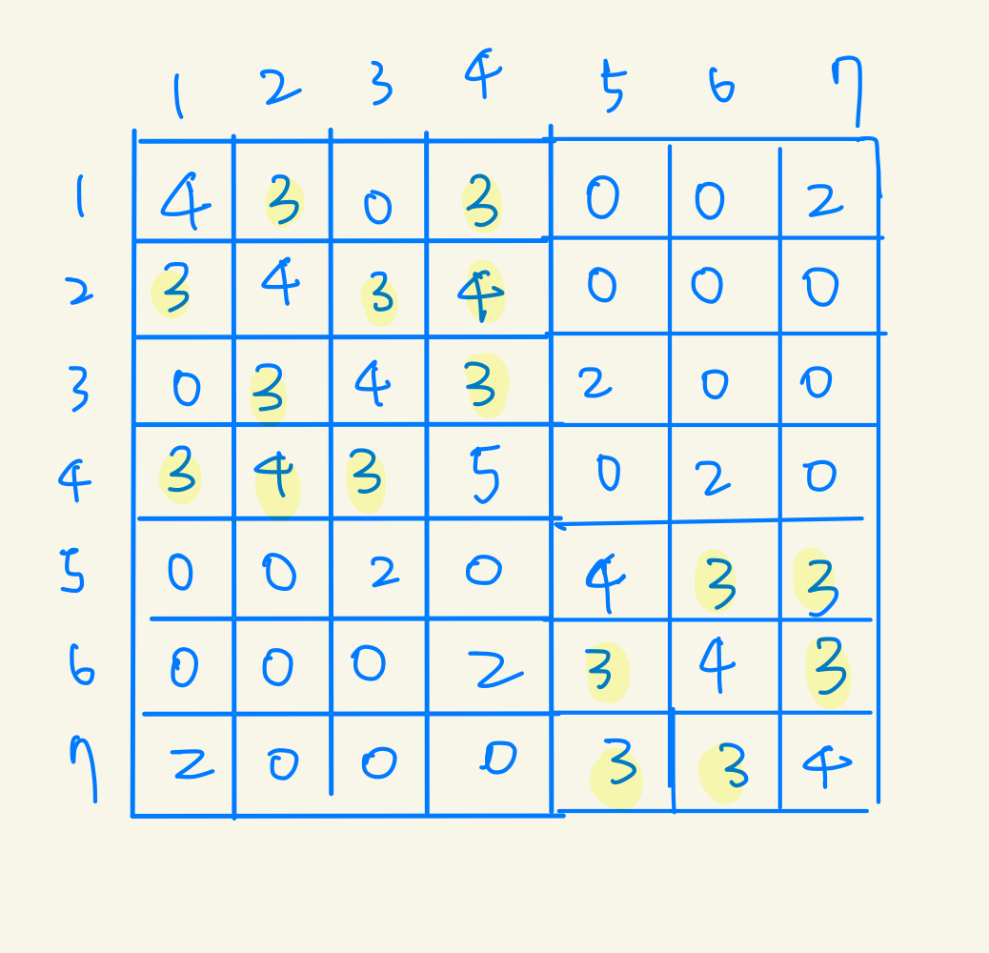
Data Augmentation
A_{s}
View Augmentation
R
A_{s}
A_{f}
A_{f}

Slide 10
Data Augmentation
Unlabeled Example Set
Notes:
perturb the raw graph with edge dropout at a certain probability 𝜌 to create a corrupted graph from where the learned user presentations are used as the unlabeled examples.

Slide 11
SEPT
Encoder
LightGCN

Slide 12
SEPT
Constructing Self-Supervision Signals
Notes:
（對偏好視圖的u2，其他兩個是圖的encoder，拿unlabeled data set中跟u2相近的前k個）

Slide 13
SEPT
neighbor-discrimination Contrastive Learning
Notes:
（與自我歧視相比，鄰居歧視利用了來自其他用戶的監督信號。
當僅使用一個正例時，如果 𝑍 ̃ 中的用戶本身對 𝒚𝑢+ 的置信度最高，則鄰居歧視退化為自歧視。

Slide 14
Loss Function
the item set that user 𝑢 has interacted with
objective of joint learning ：

Slide 15
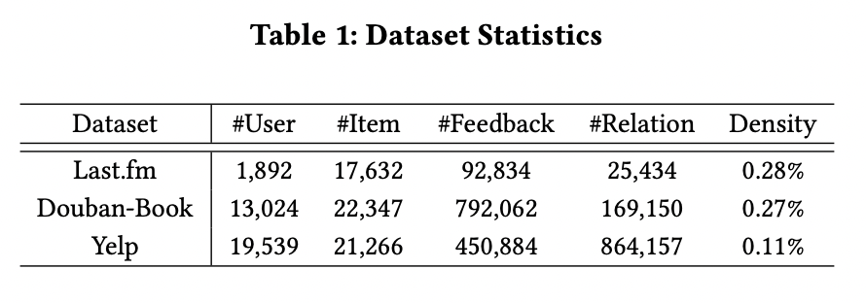
Dataset
Last.fm : 網路電台、音樂社群
Douban-Book : 豆瓣書評
Yelp : 美國最大商家評論網站

Slide 16
Baselines
• LightGCN ： GCN-based ， everages the user-item proximity to learn node representations
• DiffNet++ ：GCN-based ，models the recursive dynamic social diffusion in both the user and item spaces
• MHCN ：hypergraph convolutional network-based ，models the complex correla- tions among users with hyperedges

Slide 17
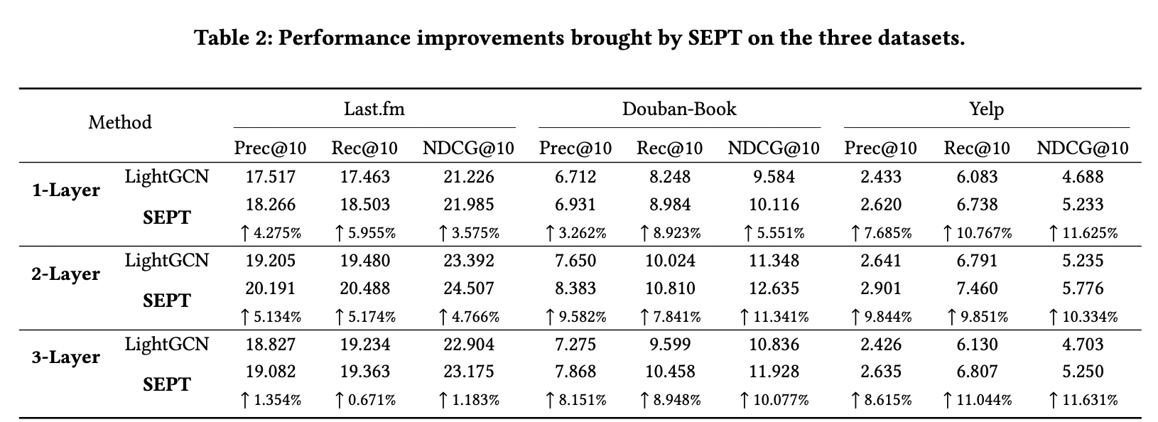
Experiment
sparser datasets

Slide 18
Experiment

Slide 19
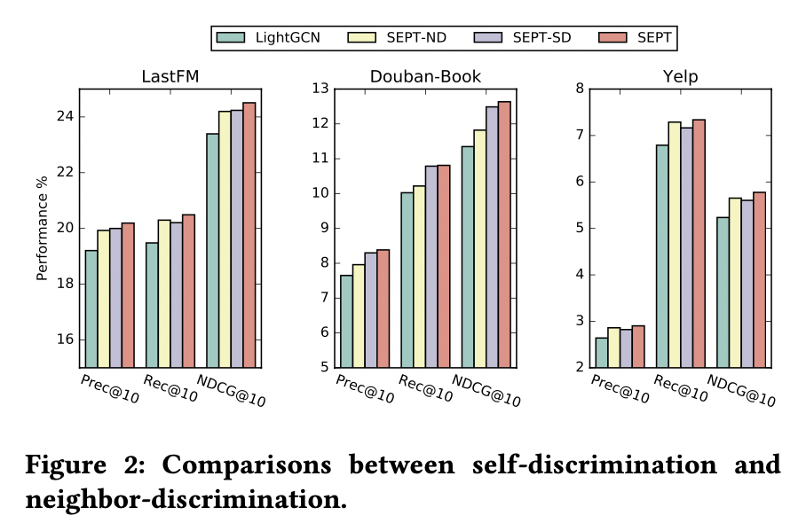
Experiment
ND≈SD
ND<SD
ND>SD

Slide 20
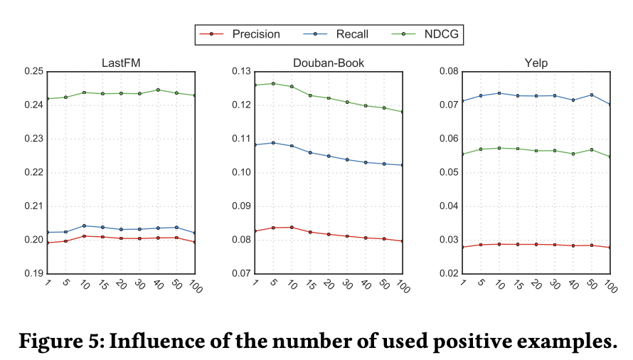
Experiment
For the influence of 𝐾in Fig.5,we fix
𝛽=0.005 on LastFM and Yelp,
𝛽 = 0.02 on Douban-Book, and 𝜌 = 0.3

Slide 21
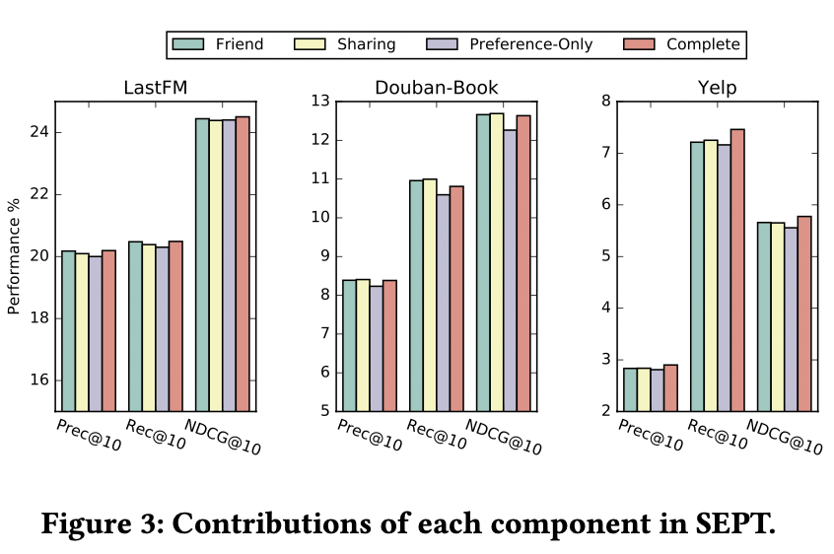
Experiment
on Douban-Book, the self-supervised co-training setting achieves the best performance

Slide 22
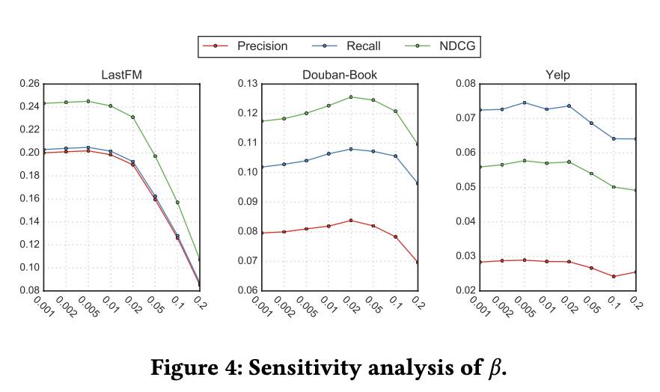
Experiment
fix 𝐾 = 10 and 𝜌=0.3

Slide 23
Conclusion
improve recommendation by discovering self-supervision signals from two complementary views of the raw data.
the neighbor-discrimination based contrastive learning method is developed to refine user representations with pseudo-labels from the neighbors.
SEPT also leverages socially-aware supervisory signals to refine user representations , also pushes users who are not semantically positive in the three views apart.
Future work:
only the self-supervision signals from users are exploited. However, items can also pseudo-labels for self-supervision.

